Slide 1
WHERE NOW
MEETS NEXT
Blockchain-Asset Tracker

Slide 2
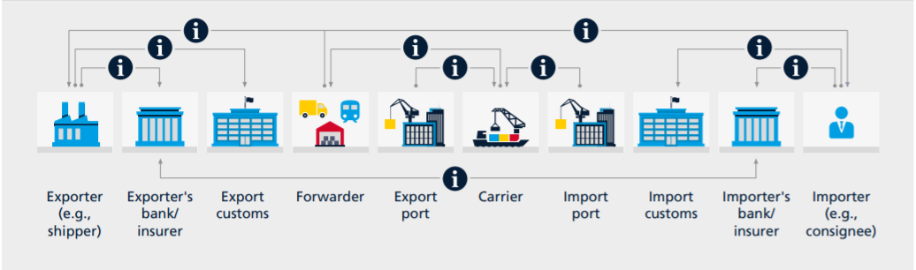
Unlocking Value in Logistics

Slide 3
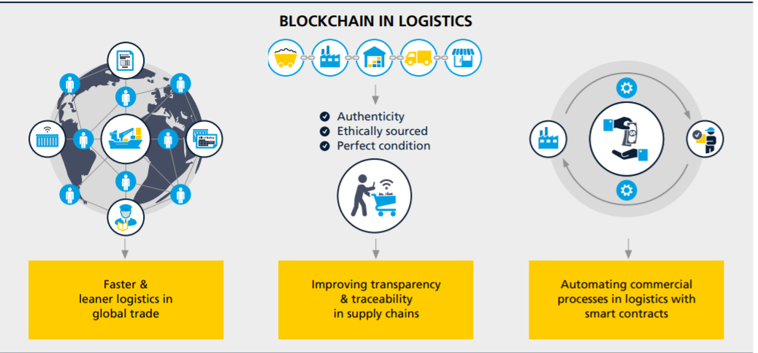
Unlocking Value in Logistics

Slide 4
Thank You

